Slide 1

Department of computer science and engineering
Project Title:Secure QR Payment Using Visual Cryptography Project
Group No. 21CS29
Presentation By:
Dakshayini B H 1NT22CS404
Sushma S 1NT22CS417
Anushree H 1NT22CS402
Nikita 1NT22CS408
Guided By:
Name of the Guide : Dr P.Nagarathna
Designation:Associate Professor

Slide 2
TABLE OF CONTENTS
Background
Research motivation and Problem Statement
Literature Survey
Research objectives
Design and Implementation.
Results
Conclusion
References
Patents/Publications Proof

Slide 3
Background
QR Code Risks
Visual Cryptography
Blockchain Integration
Secure Payment System

Slide 4
Research motivation and Problem Statement
Public Key Cryptography Limitations
Key management
Computational Overhead
Static QR codes
Multithreading time complexity
Problem Statement :
To secure QR payment systems, Visual Cryptography encrypts data, while multi-factor authentication (MFA) adds extra security. Blockchain ensures transparent transactions, and real-time fraud detection identifies threats. Tokenization replaces sensitive data with secure tokens, and smart contracts validate transactions. A user-friendly interface ensures a seamless, secure experience.

Slide 5
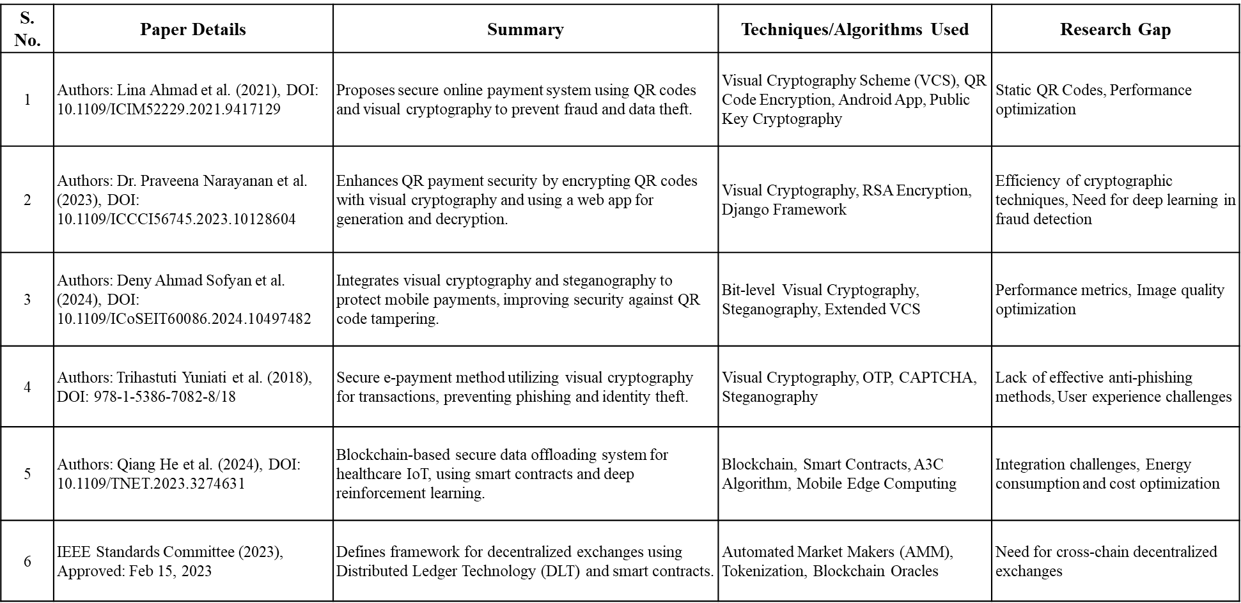
Literature Survey

Slide 6
Research objectives
Data Security and Integrity: Enhance Visual Cryptography Scheme (VCS) for improved data protection and ensure data integrity through blockchain technology.
Blockchain and DLT: Implement decentralized ledger technology (DLT) for secure, transparent transactions and create NFTs for asset verification.
Smart Contracts: Utilize smart contracts for automating authentication and authorization, ensuring secure and efficient user transactions.
User Interface and Transaction Security: Develop a user-friendly UI/UX design to facilitate secure and transparent money transactions.

Slide 7
Proposed solution
Secure Asset Verification and Authentication System using Decentralized Ledger Technology and Visual Cryptography-Enhanced QR Codes, in Payment Systems

Slide 8
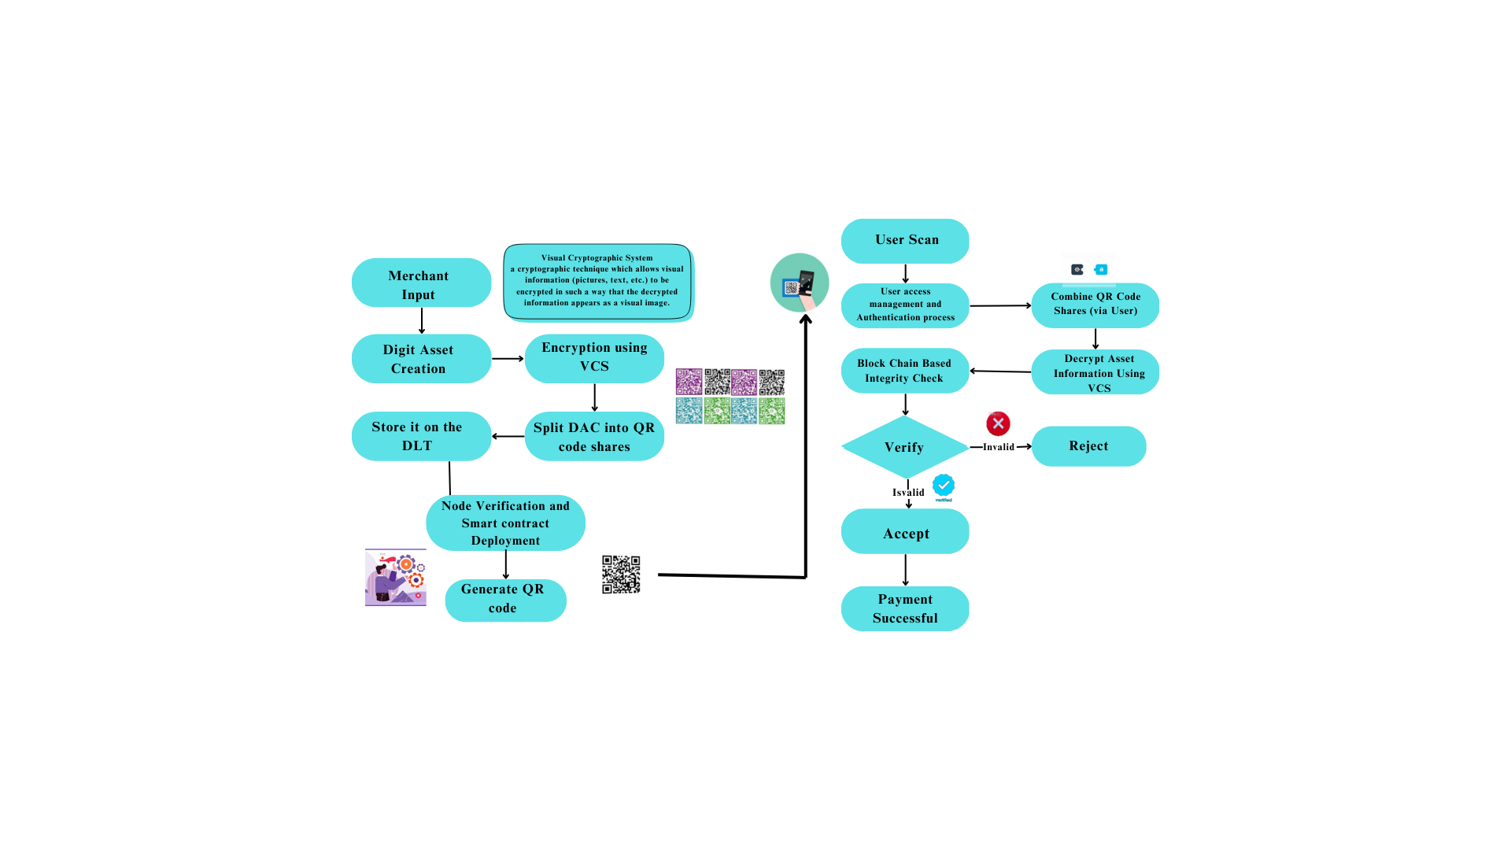
Design and Implementation

Slide 9
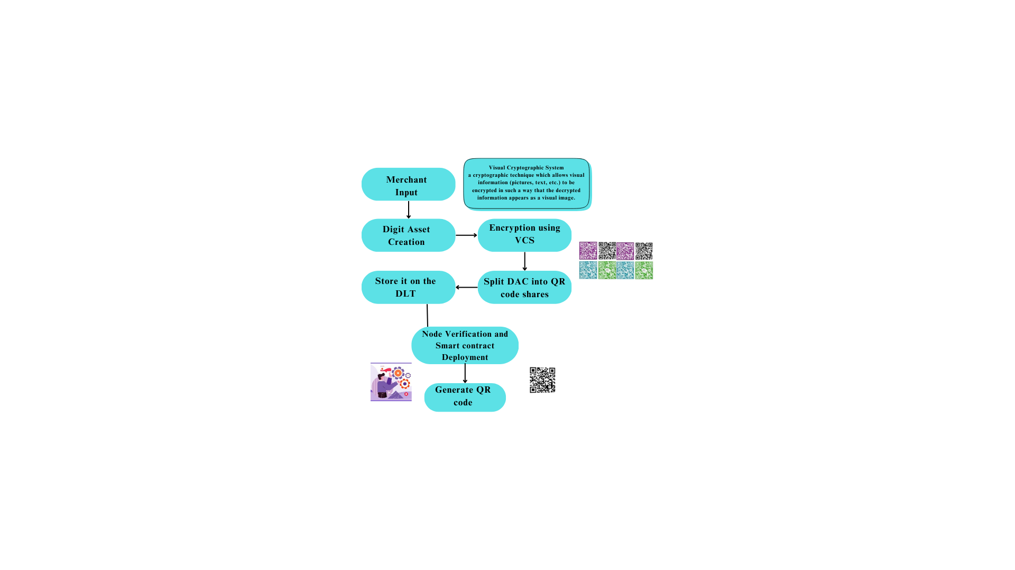

Slide 10
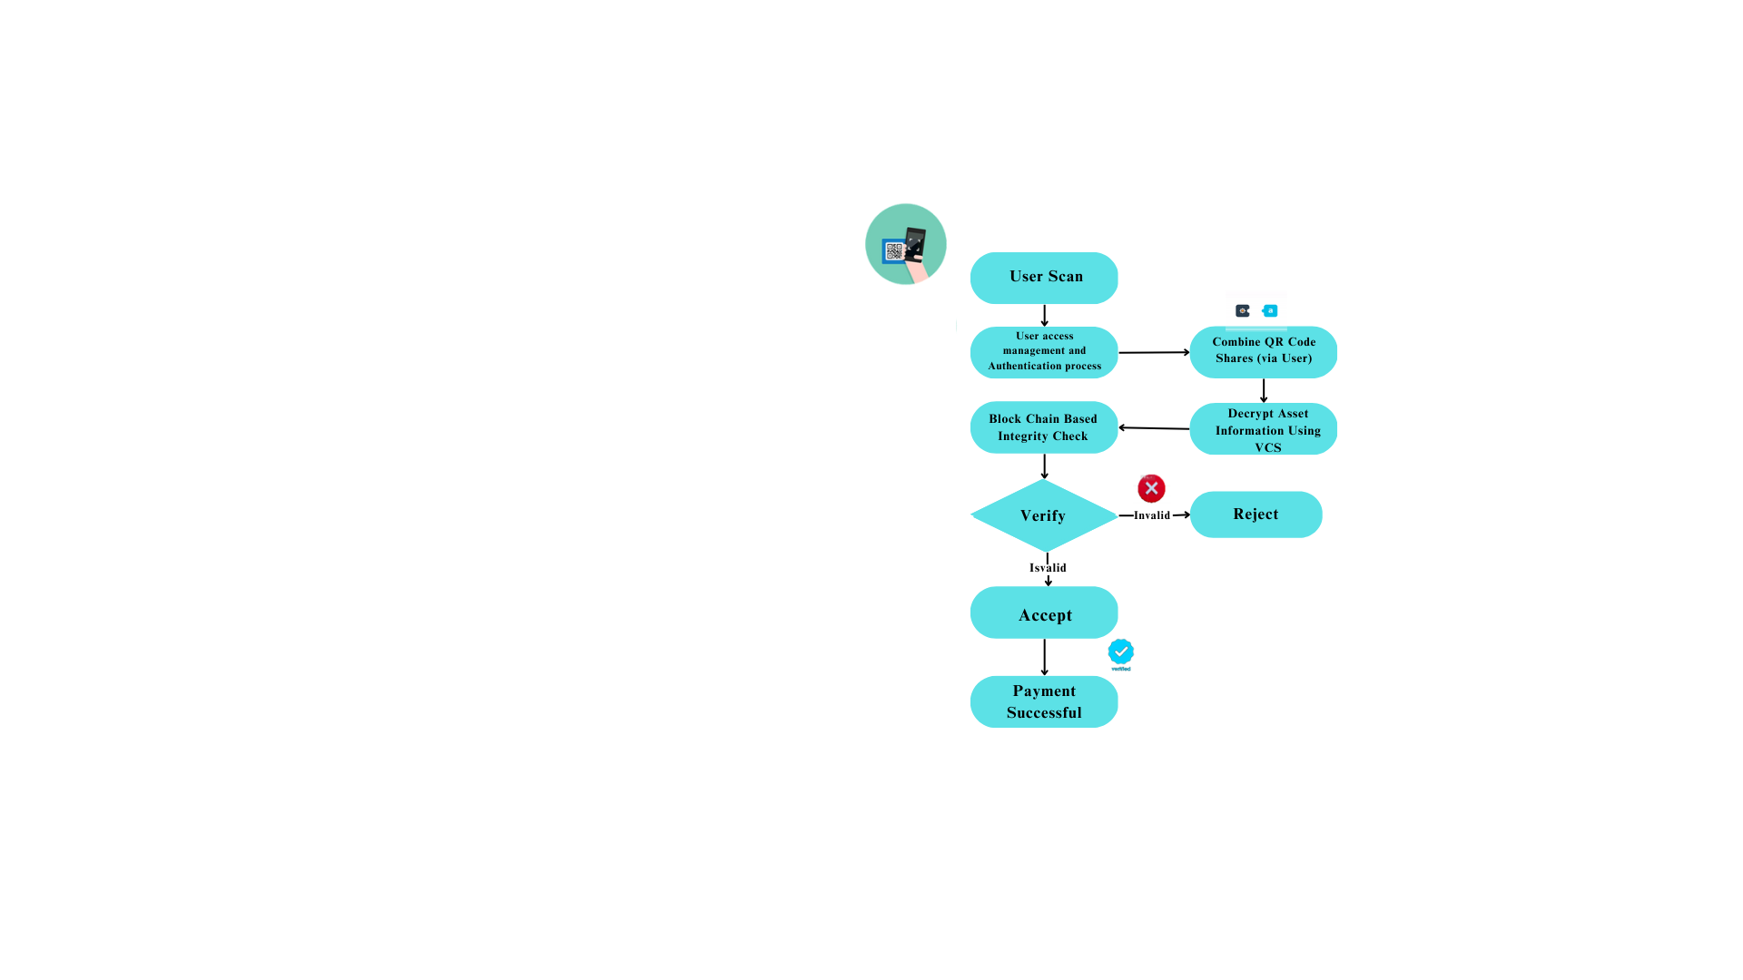

Slide 11
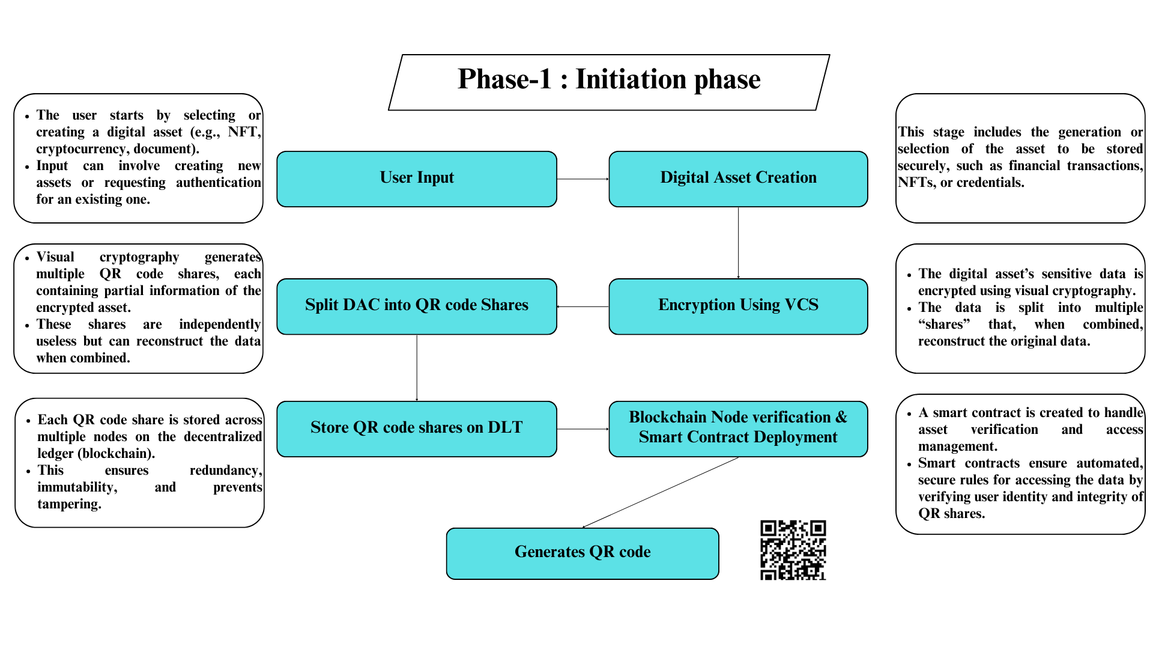
RESULTS

Slide 12
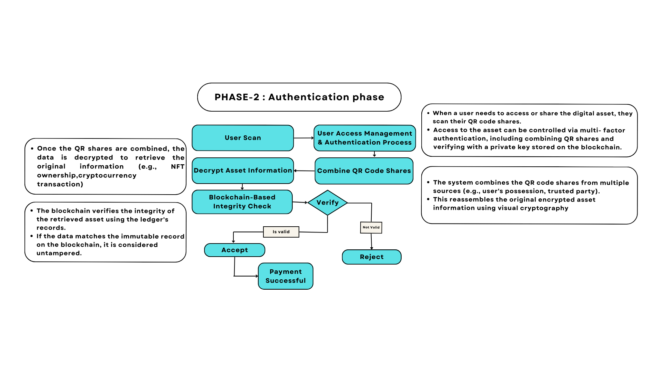
RESULTS

Slide 13
Conclusion
This project combines blockchain with visual cryptography-enhanced QR codes to ensure secure data storage and privacy.
Encrypted shares in QR codes are combined to reveal information, while smart contracts automate secure, transparent transactions.
Potential uses include financial security, digital identity, and supply chain transparency

Slide 14
References
L. Ahmad, R. Al-Sabha, and A. Al-Haj, "Design and Implementation of a Secure QR Payment System Based on Visual Cryptography," Department of Computer Engineering, Princess Sumaya University for Technology, Amman, Jordan, 2022.
P. Narayanan, "Design of Secure QR Payment System Using Visual Cryptography Method," Department of Computer Science and Technology, Madanapalle Institute of Technology & Science, Madanapalle, India, 2022.
D. A. Sofyan, S. Mandala, and E. M. Jadied, "Mobile Payment Authentication Using QR Code Based on Visual Cryptography Scheme," School of Computing, Telkom University, Bandung, Indonesia, 2022.
T. Yuniati, "Secure E-Payment Method Based on Visual Cryptography," School of Electrical Engineering and Informatics, Institute of Technology Bandung, Bandung, Indonesia, 2022.
IEEE Std 2140.4-2023, "IEEE Standard for Distributed/Decentralized Exchange Framework using Distributed Ledger Technology (DLT)," IEEE Std 2140.4-2023, vol., no., pp. 1-19, 13 April 2023, doi: 10.1109/IEEESTD.2023.10101743.

Slide 15
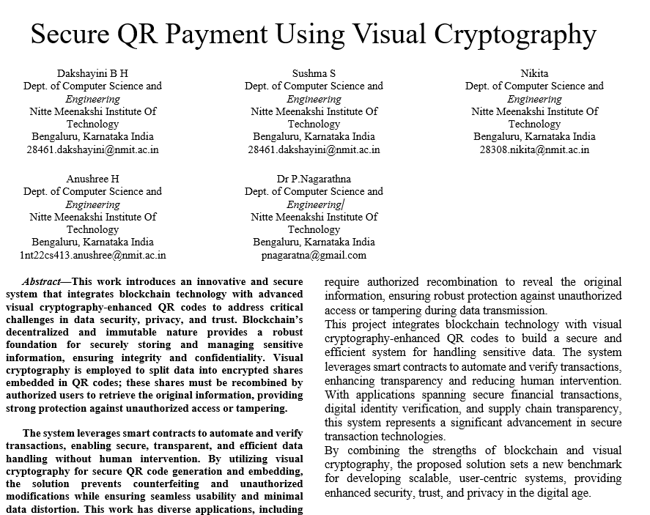
Patents/Publications Proof

